Slide 1
Used Car Price Prediction
Submitted by,
Raj Sharma

Slide 2
Content:
Introduction
Problem Statement
Insights of the project
Analytical Problem Facing
EDA
Visualizations
Data Pre Processing and Feature Engineering
Model Development and Evaluation
Conclusion

Slide 3
Introduction:
With the covid 19 impact in the market, we have seen lot of changes in the car market. Now some cars are in demand hence making them costly and some are not in demand hence cheaper. One of our clients works with small traders, who sell used cars. With the change in market due to covid 19 impact, our client is facing problems with their previous car price valuation machine learning models. So, they are looking for new machine learning models from new data. We have to make car price valuation model.

Slide 4
Problem Statement:
Based on the business requirements of the Client, data is scrapped from the well-known e-commerce websites such as cars 24, OLX and cardekho.com. Based on the Data collected, we will be predicting the prices of used cars. We will be building various Machine Learning models. In the end, we will see how all the machine learning models performs. And based on which we will sort the best machine learning model and hyperparameter tune the same to get the improved performance.

Slide 5
Insights of Project:
As per the requirement of our client, data is scraped from different used cars selling merchants websites, and so based on the data collected I have tried analysing based on
What factors the used car price is decided?
What is the relationship between cost of the used cars and other factors like Fuel type, Brand and Model, year the car is purchased and Number of owners before selling?
And so based on all the above consideration I have developed a model that will predict the price of the used cars.

Slide 6
Analytical Problem Facing:
Analytic problem framing involves translating the business problem into terms that can be addressed analytically via data and modeling. Analytic problem framing is the antithesis of merely working with the ready-to-hand data and seeing what comes of it, hoping for something insightful.

Slide 7
Exploratory data analysis
In Used Car Price prediction problem data is scrapped using webscraping selenium from cardekho website.
First, the analysis is started with importing the data, this dataset contains no Null values and unnecessary columns which does not contribute for the target variable is removed.
Once data is cleaned outliers and skewness are checked, if present they are removed then in Data Pre-processing, Standard Scaler is used to standardize the data and by using VIF, multicollinearity is removed.

Slide 8
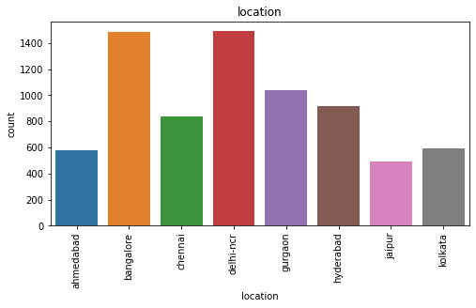
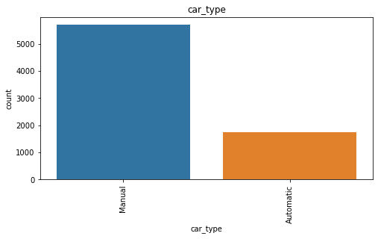
Visualization:
In our dataset, Bangalore and Delhi-NCR locations sees high sell of used cars followed by Gurgaon, Jaipur sees less amount of used cars selling
Manual cars are sold in large amount compared to automatic cars.

Slide 9
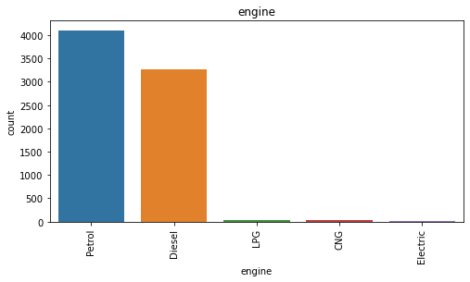
Cont.
Petrol engine cars are more sold for high price compared to other engine type, followed by diesel engine cars and the lowest running type is electric.

Slide 10
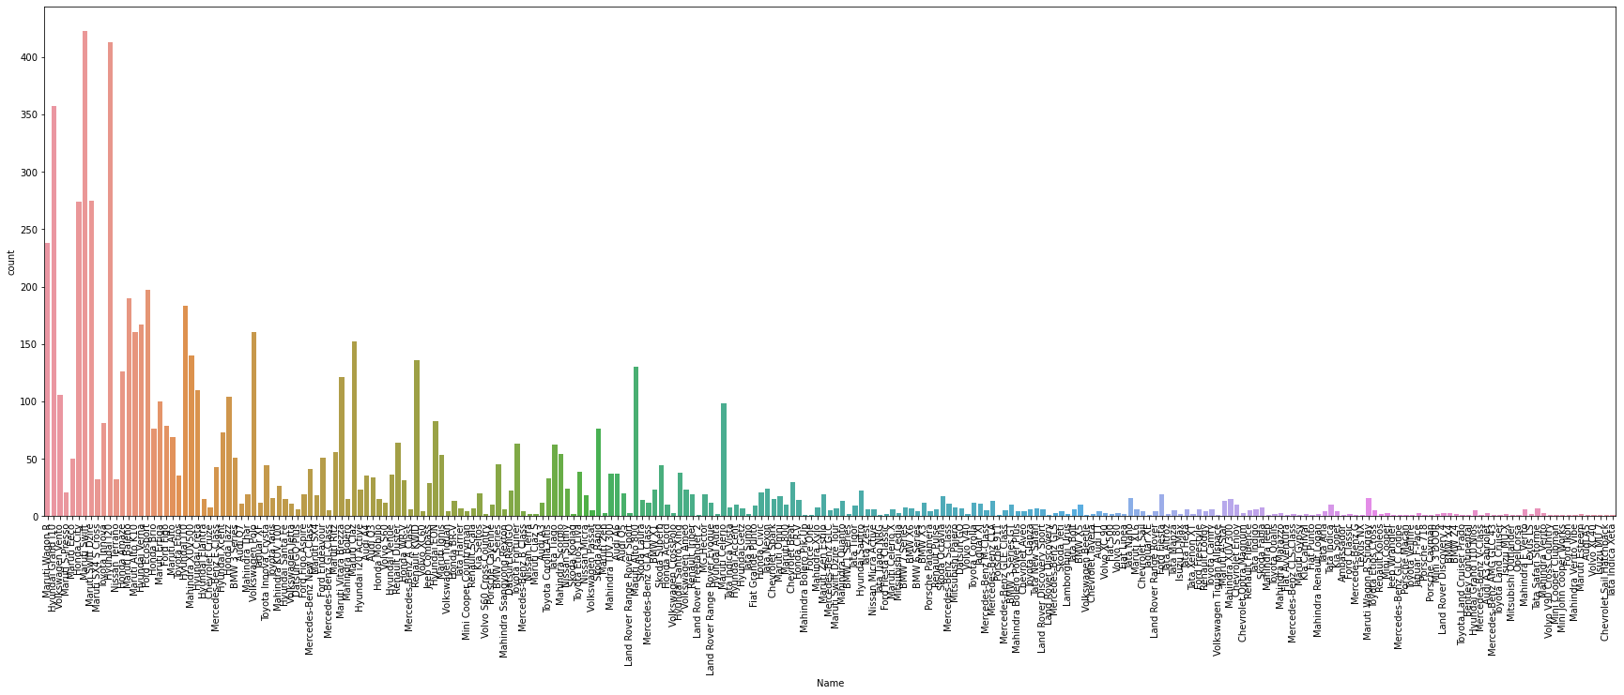
Cont.
Maruti swift followed by Hyundai i20 are sold more followed by Maruti WagonR. Least sold brands are Minicoper, Cheverolet.

Slide 11
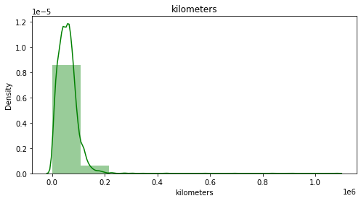
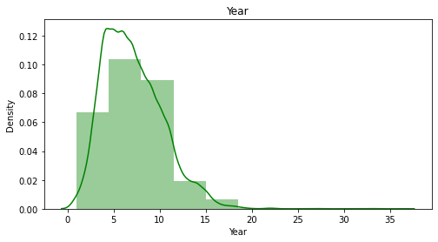
Visualization of Categorical data:
1. Kilometers and Year columns both are skewed.

Slide 12
Data Pre-Processing and Feature Engineering:
In Machine Learning, data pre-processing refers to the process of cleaning and organising raw data in order to make it appropriate for creating and training Machine Learning models.
In other words, anytime data is received from various sources, it is collected in raw format, which makes analysis impossible. Data pre-processing is a crucial stage in Machine Learning since the quality of data and the relevant information that can be gleaned from it has a direct impact on our model's capacity to learn; consequently, we must pre-process our data before feeding it into our model.
As a result, it is the first and most important stage in developing a machine learning model. Some of the techniques used in this project are listed below:
Started with importing the required libraries and then the train dataset which is in excel.
As the dataset contains 7 variables. Then the information of the columns are observed carefully.

Slide 13
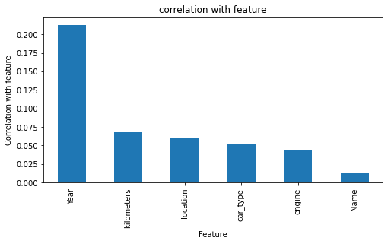
Correlation:
corr() is used to find the pairwise correlation of all columns in the dataframe.
In this project correlation is done with target variable ‘SalePrice’, by which we can observe that OverallQual, GrLivArea is highly positively correlated with target column, whereas BsmtQual, ExterQual is highly negatively correlated with target column.

Slide 14
Outliers:
An outlier is an observation that lies an abnormal distance from other values in a random sample from a population.
In this project mostly all columns contains outliers which is visualized in next slide.
These Outliers are removed by Z-Score.

Slide 15
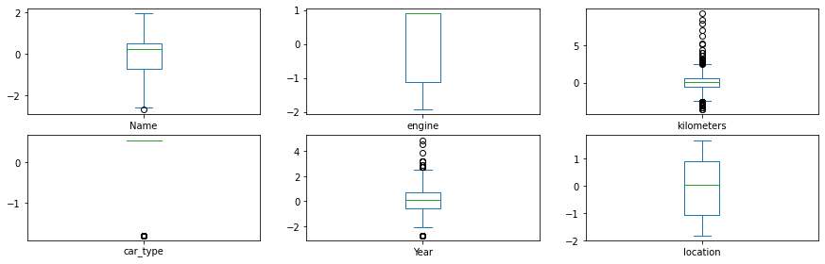
Outliers are present in 'kilometers' , 'car_type', 'Year'

Slide 16
Skewness:
Skewness refers to a distortion or asymmetry that deviates from the symmetrical bell curve, or normal distribution, in a set of data.
Keeping skew values +/- 0.5 we can find that most columns have more value of skew.
Here in this project, power transform method is used to remove skewness and to get high accuracy of the model.

Slide 17
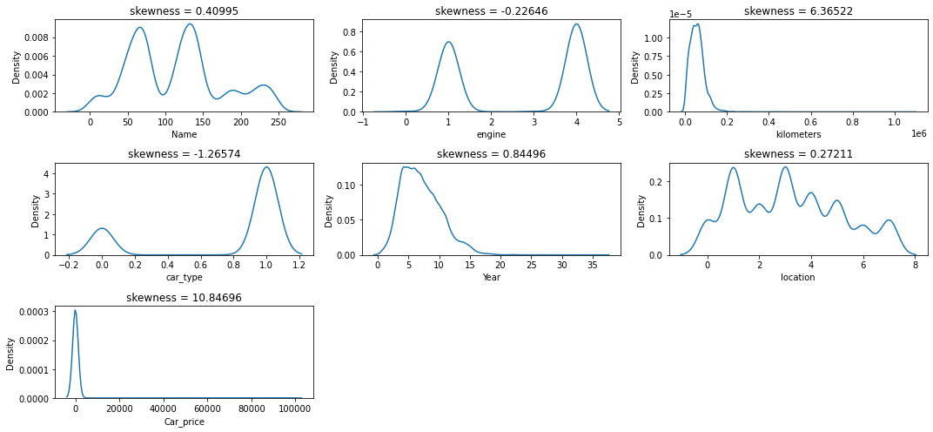
Skewness is present in 'Name', 'engine', 'kilometers', 'car_type', 'Year' columns

Slide 18
Cont.
Outliers and Skewness is checked and removed in order to avoid bias while model building.
Standard Scaler is used for data standardization and VIF is used to check Multicolinearity is checked to find if any data variable is correlated with each other and it is removed.
Once all these processes are done then data is ready for model building where various Machine Learning models is used to check the accuracy of data.

Slide 19
Model Development and Evaluation
The approaches followed in this project are
Find the best random state of a model.
Use all the other models to find accuracy score, mean squared error, mean absolute error and r2 score.
Then find Cross Validation of all models to find the best accuracy, which is the least difference between r2 score and cv score.
With the best model accuracy, we need to do hyper tuning using GridSearchCV.
Then finally saving the best model and by keeping this we need to predict the Car_Price of test dataset.

Slide 20
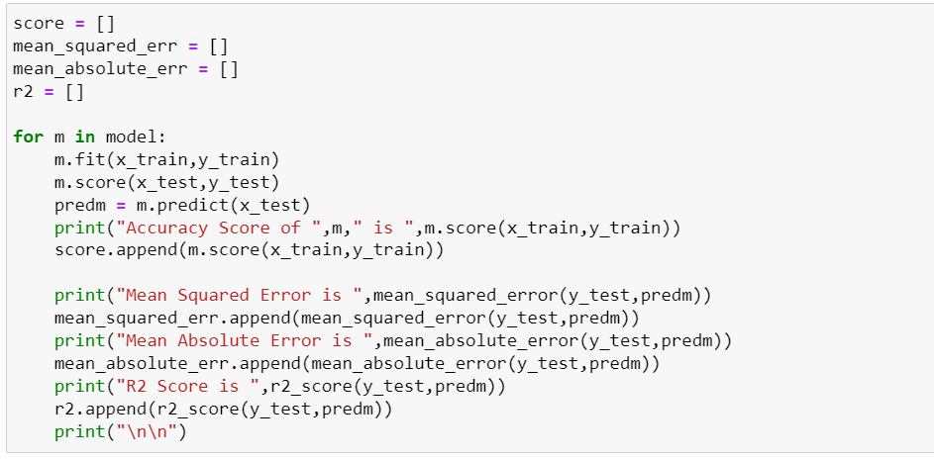
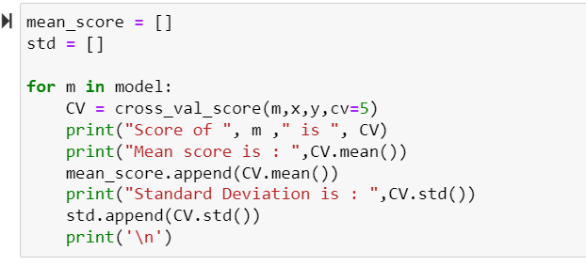
Here accuracy score,r2_score, mse , cv is checked for all models and final model is selected.

Slide 21
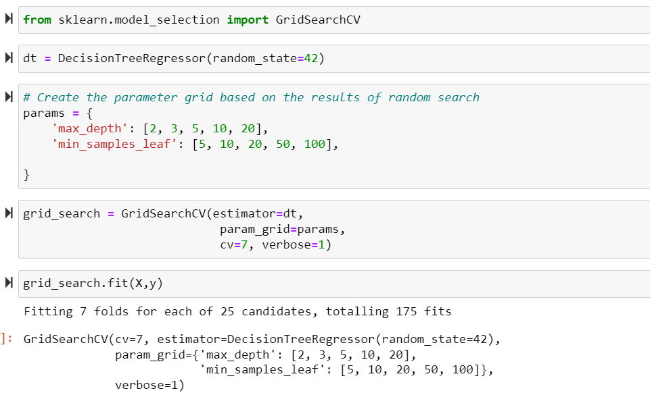
Hypertuning is done to improve model accuracy for DecisionTreeRegressor. By which we improved our accuracy from 84 to 91 percent
HyperTuning:

Slide 22
Conclusion:
The above research will help our client to study about the latest used car market and with the help of the model built he can easily predict the price ranges of the cars, and also will helps him to understand based on what factors the Car Price is decided.

